Slide 1
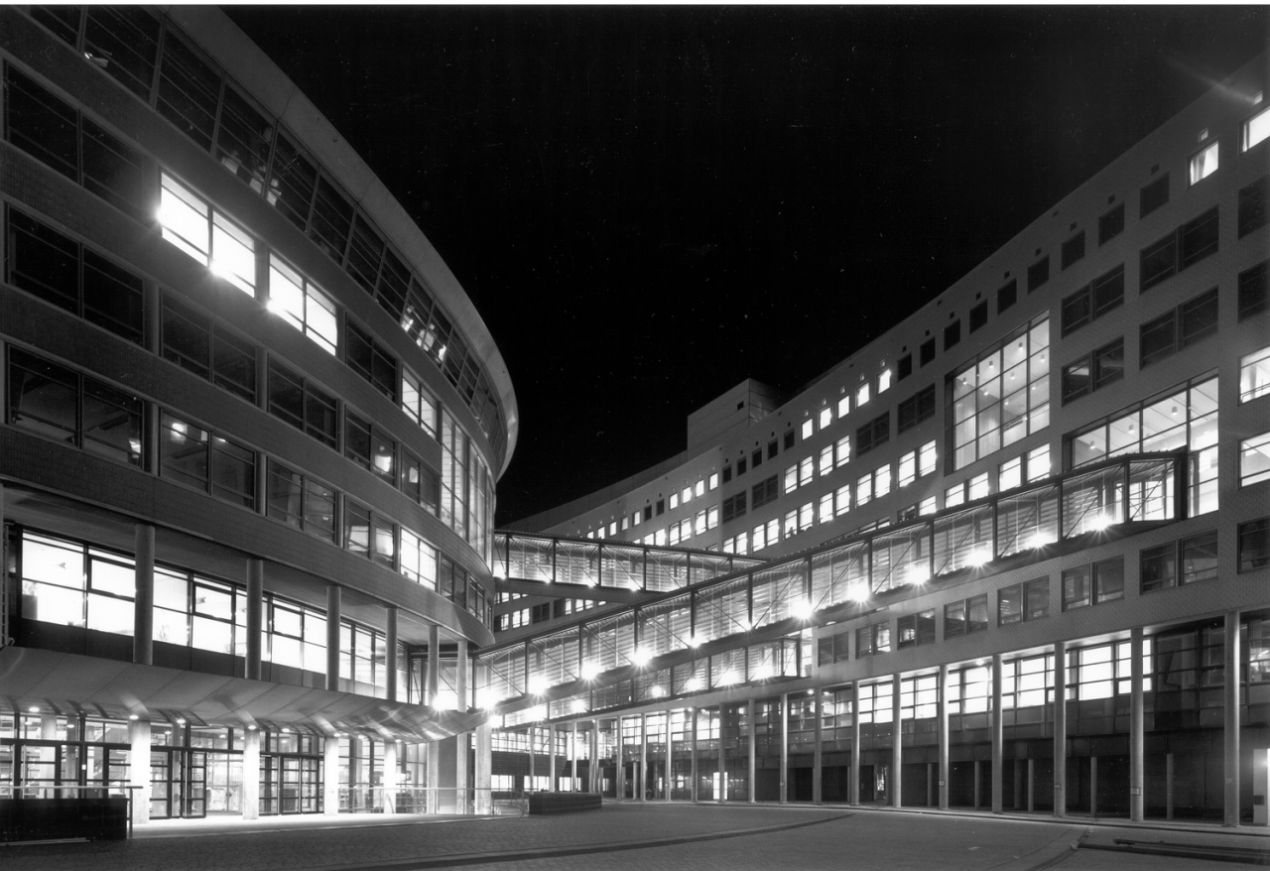


OPSCHALER
Megan Meezen
Daan Boesten
Brian de Keijzer
Victor Gómez
Engineer V. García
Pol de Visser
[1] 05-10-2018

Slide 2


Contents
Dwelling data information
Bokeh live demonstration
Some correlation stuff
[2]

Slide 3

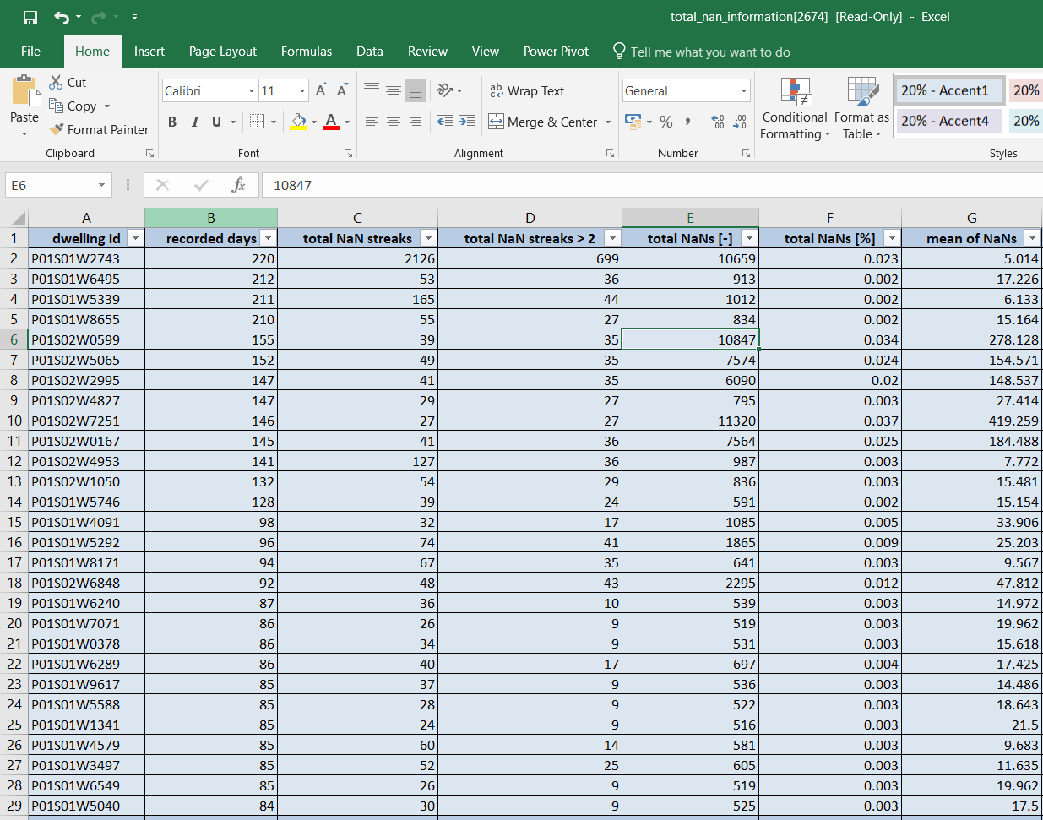
[1]

Slide 4
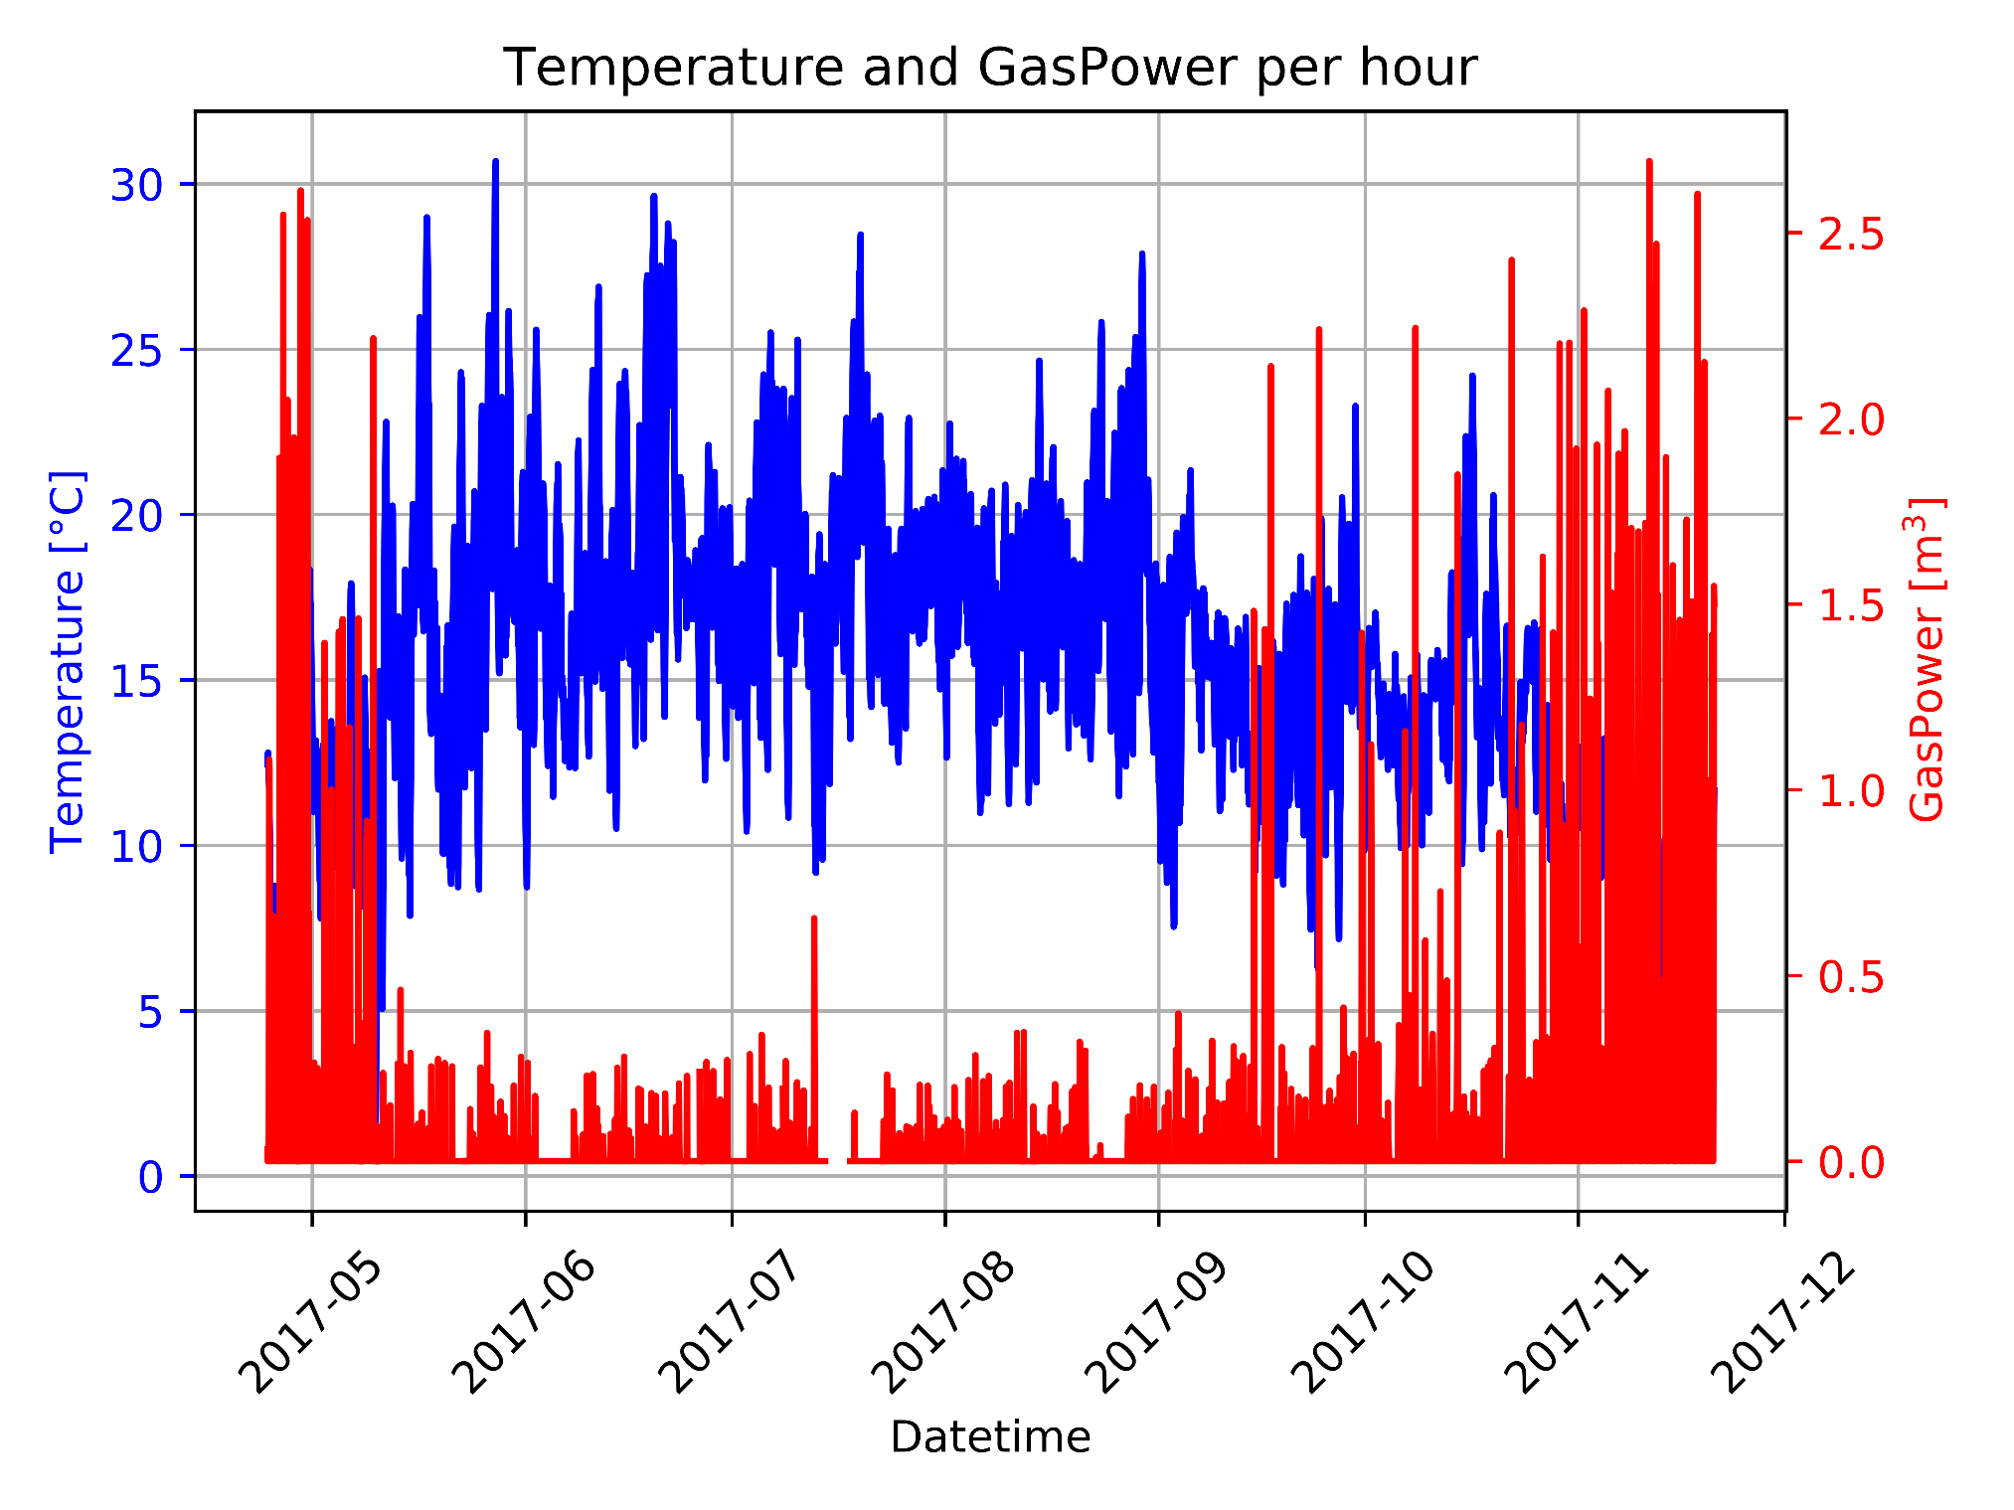
[1]

Slide 5
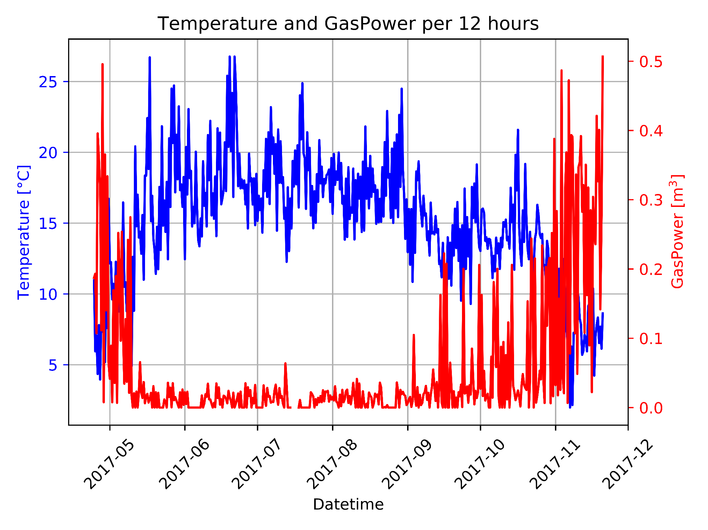
[4]

Slide 6
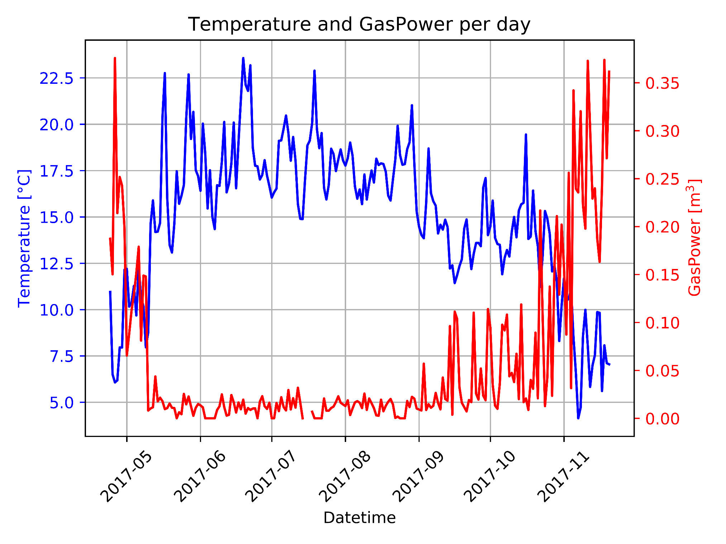
[5]

Slide 7
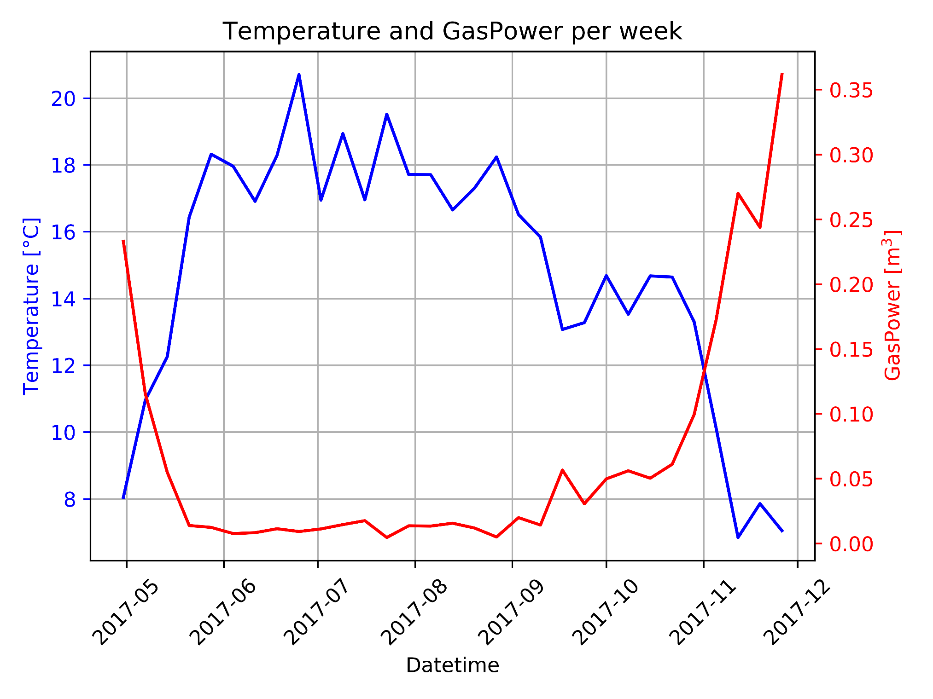
[5]

Slide 8
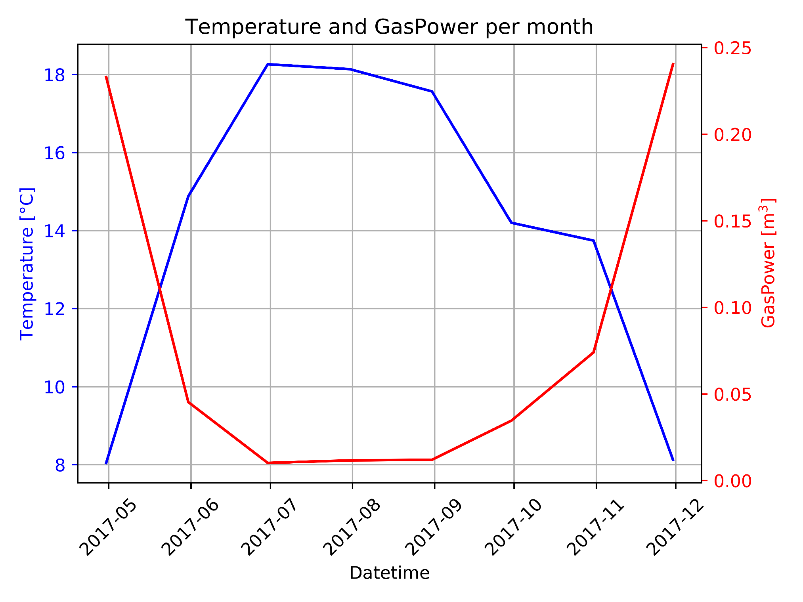
[6]

Slide 9
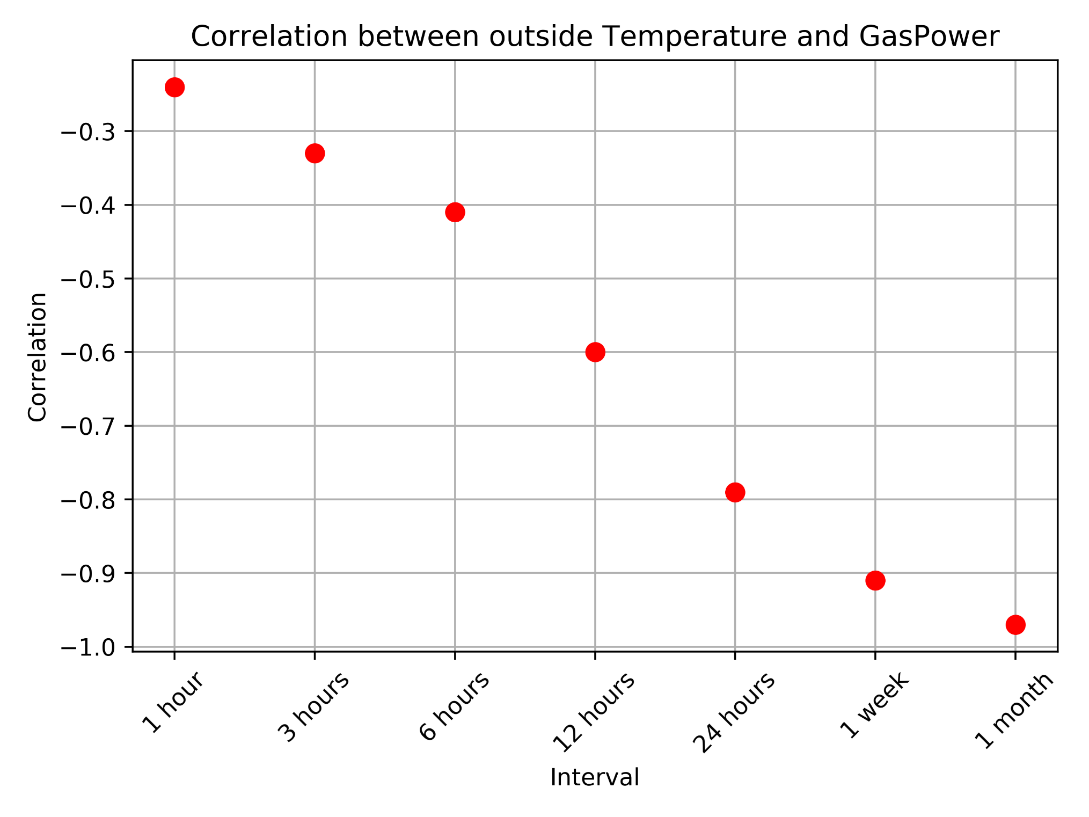
[6]

Slide 10
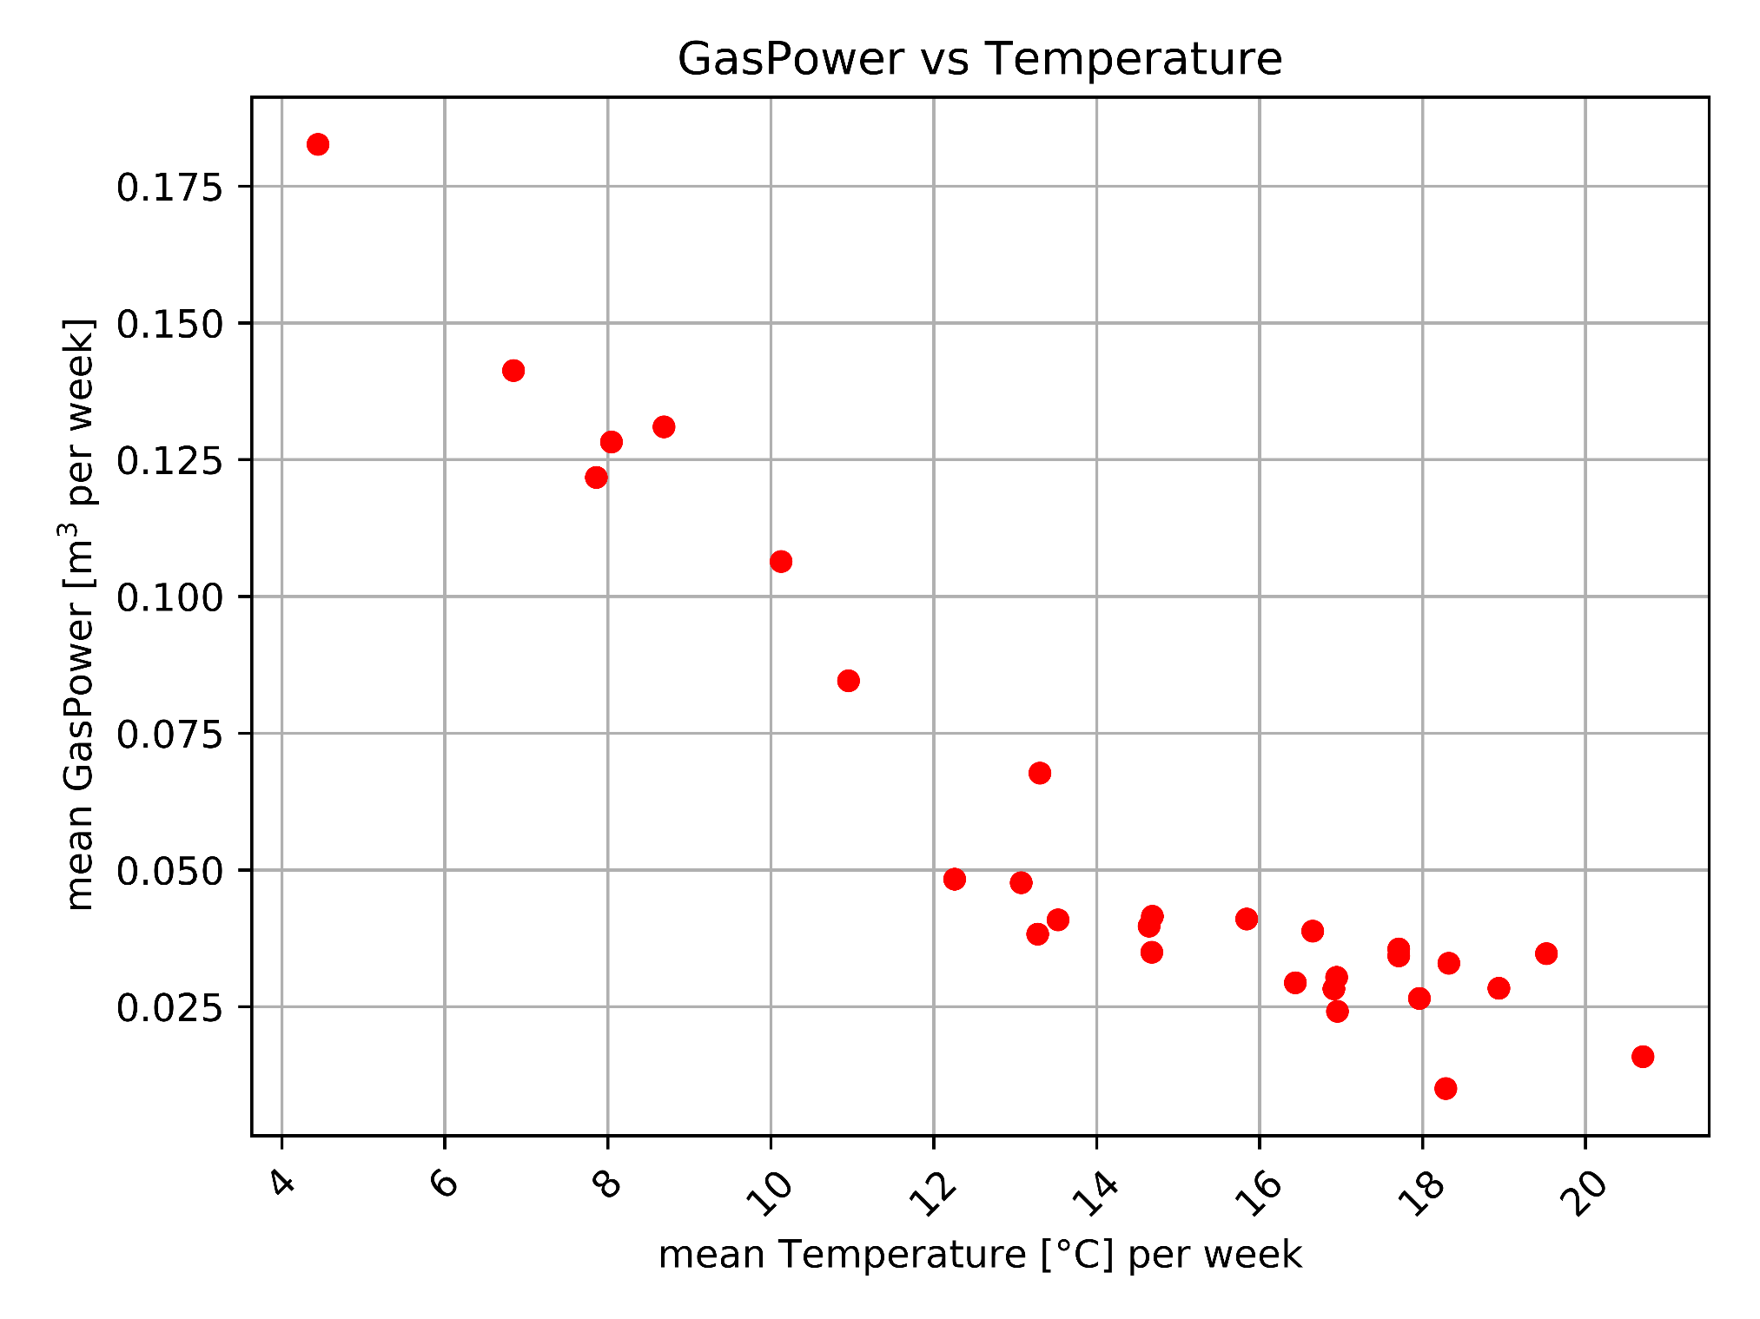
[6]

Slide 11
Next week
Further develop Bokeh
Some more correlation stuff
Start applying different prediction models
[2]

